Slide 1


EE6352 Embedded System Design
Authenticated Voting Machine using RFID
Group No :13
Members
EG/2020/3967
EG/2020/3974
EG/2020/3975
EG/2020/3976
EG/2020/3977
Department of Electrical and Information Engineering
Faculty of Engineering
University of Ruhuna Sri Lanka

Slide 2


TABLE OF CONTENTS
Introduction
Solution
Features
Flow Chart
Components
Protues Solution with Code
1

Slide 3


Introduction
Concerns about today elections
Fairness and security in Elections
Accuracy and efficiency problems
Cost issues
Voter Fraud and Unauthorized Voting
Transparency and Accountability
Data Integrity
Public Trust
Resource Management
2

Slide 4

Solution
Develop a voting system utilizing RFID technology for authentication.
Ensure only qualified voters can cast votes using RFID tags.
Simplify voting process while enhancing security measures.
Design voting machine safeguards to prevent unauthorized voting and electoral cheating.
Utilize RFID tags for reliable identity verification of registered voters.
Establish secure verification process using RFID tags.
Ensure only legalized votes are counted, maintaining voting
process integrity.
3

Slide 5



Features
RFID Authentication
The system allows only authorized voters to cast their votes by authenticating RFID tags.
01
Secure Voting
By utilizing RFID technology, the system ensures secure and tamper-proof voting, reducing the risk of fraudulent voting practices.
02
4

Slide 6

User Interface
The system features an interface with a 16x2 LCD display for displaying voter information and voting results. LED indicators provide visual feedback during the voting process.
03
Button-Based Voting
Voters can cast their votes by pressing corresponding buttons assigned to each candidate. The system records and displays the votes in real-time on the LCD screen.
04
5

Slide 7
Scalability
The system is scalable and can accommodate a varying number of candidates and voters by adjusting the program parameters and hardware configuration accordingly.
05
06
Automatic Vote Counting
The microcontroller automatically tallies the votes and updates the count for each candidate, eliminating the need for manual counting and reducing human errors.
6

Slide 8
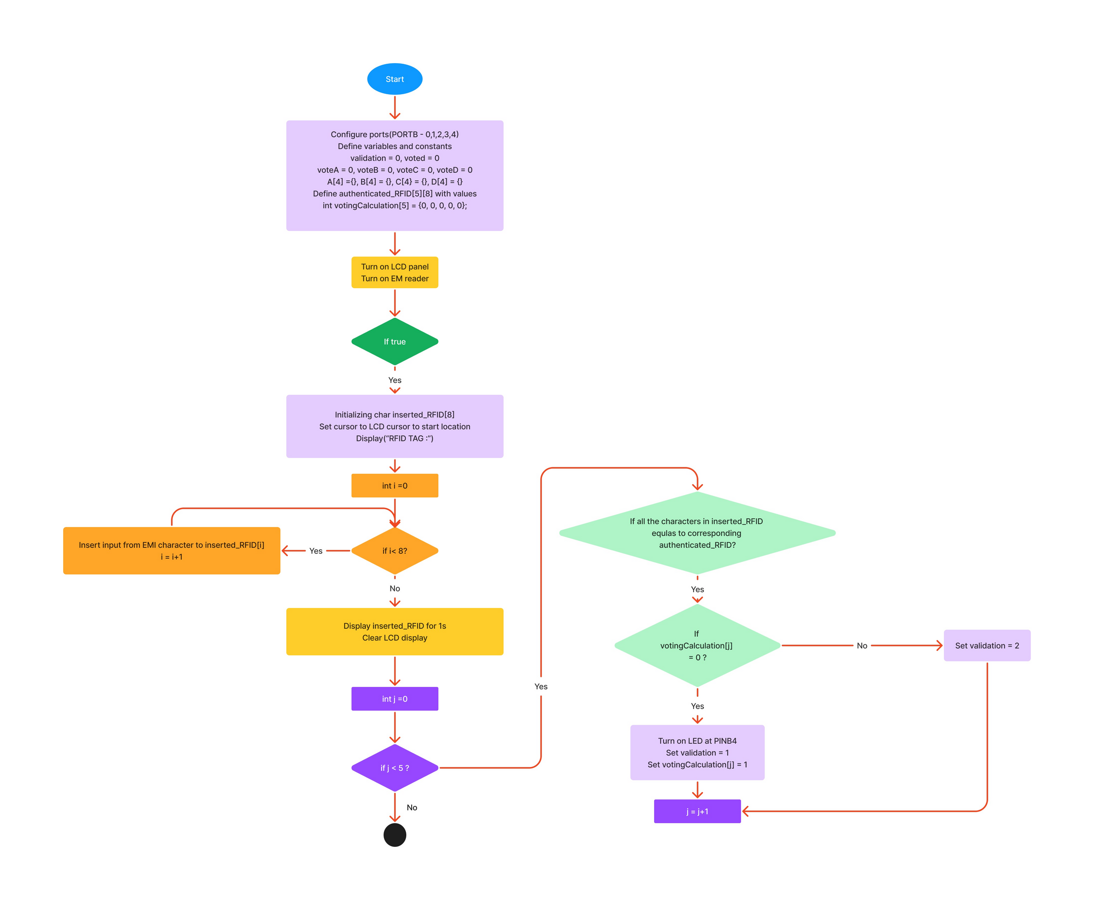
Flow Chart
7

Slide 9
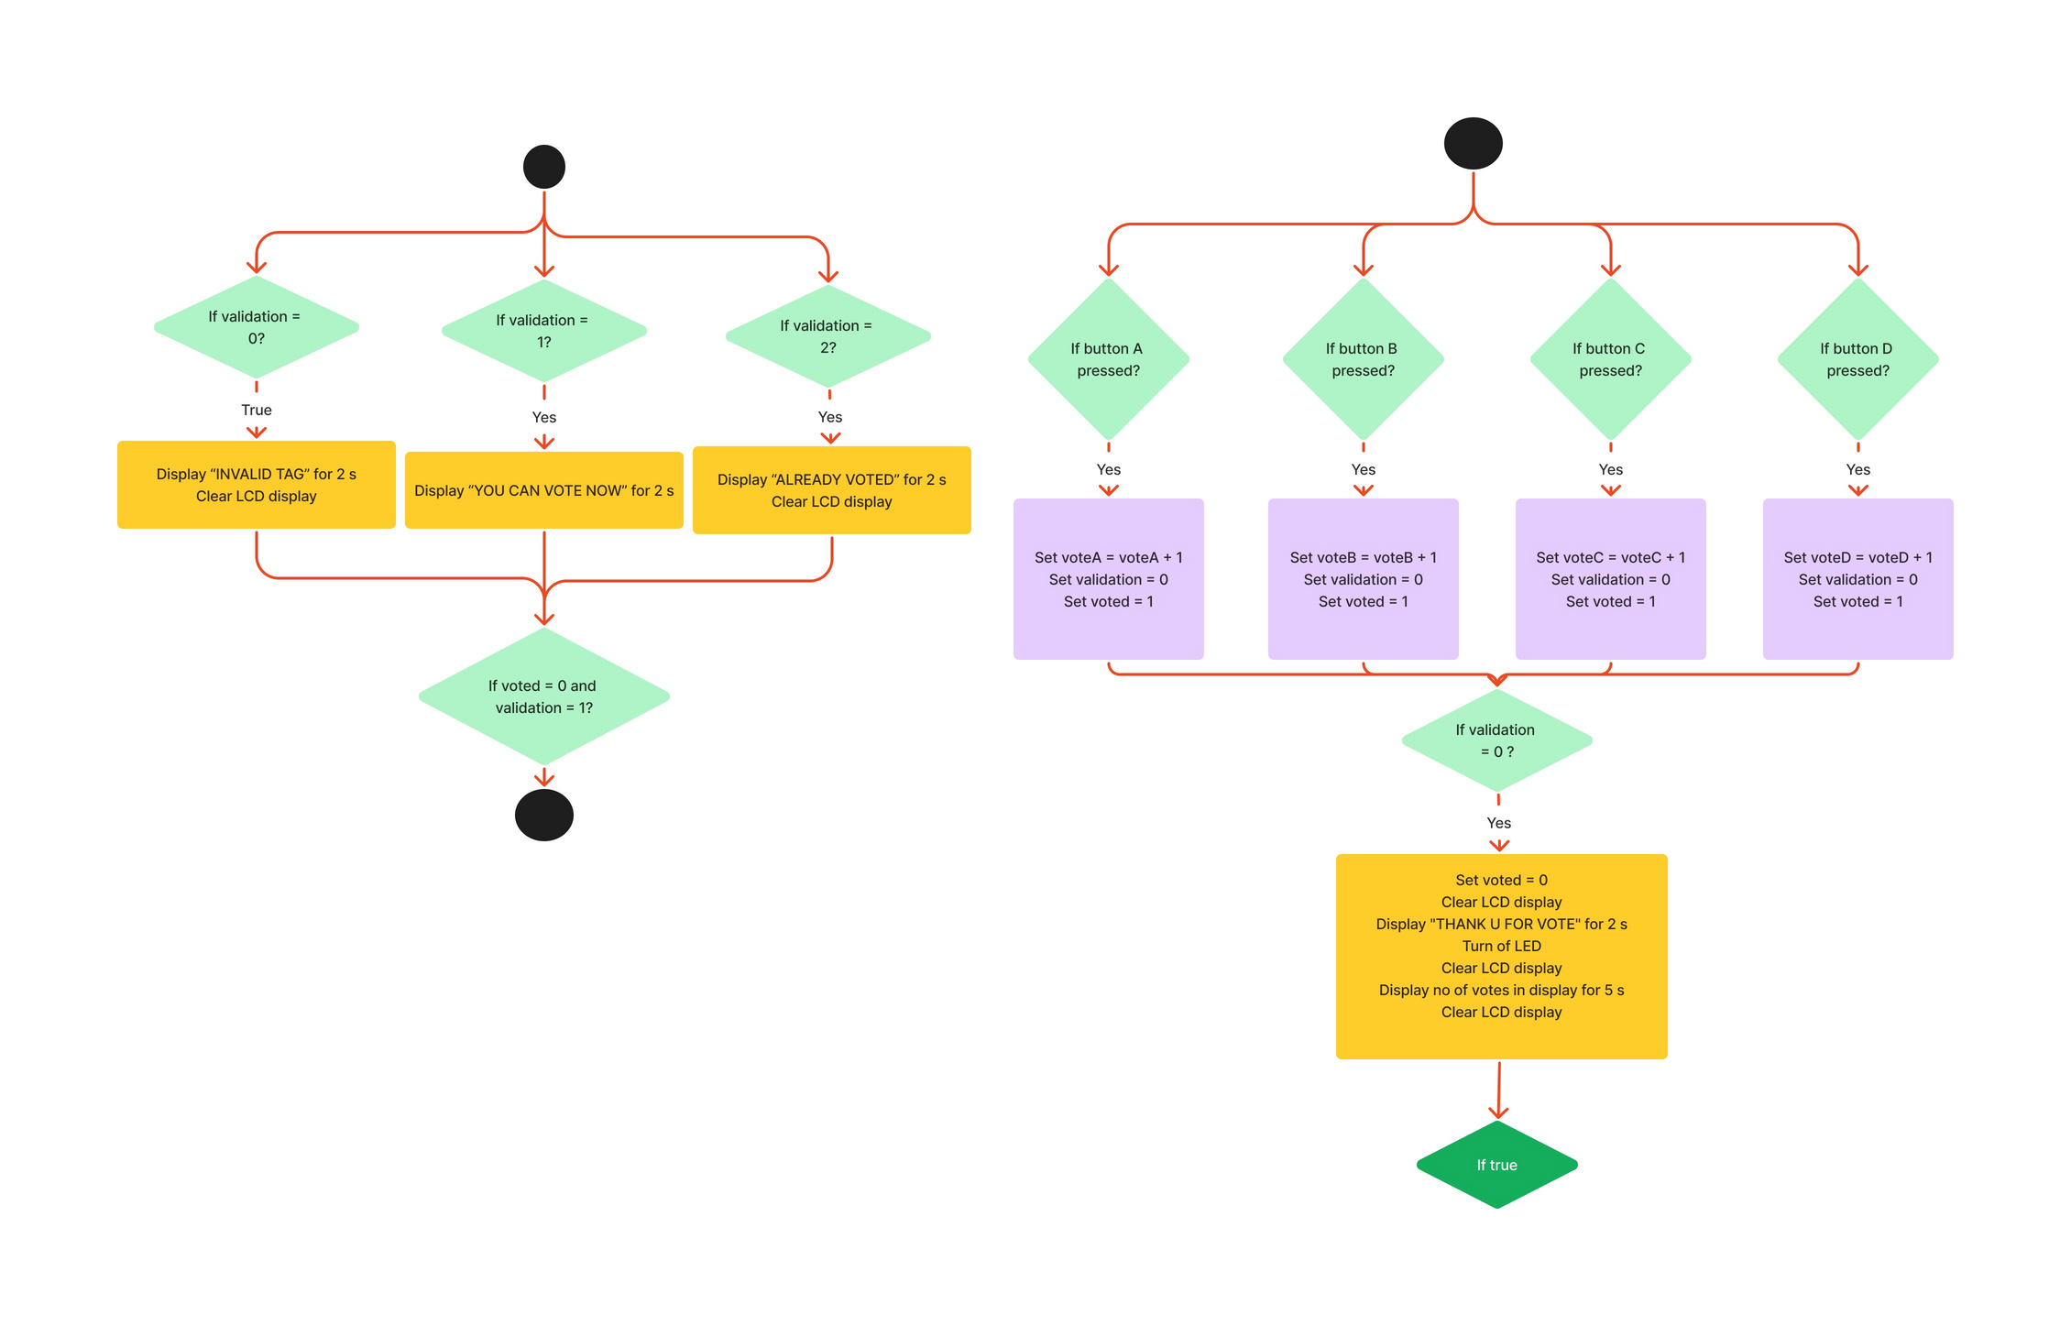
8

Slide 10
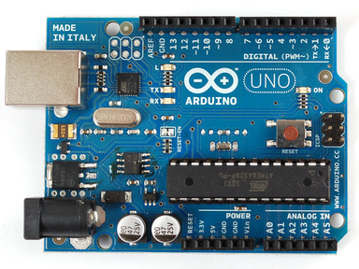
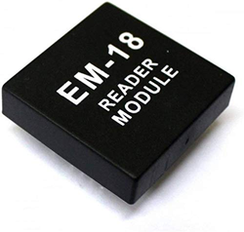
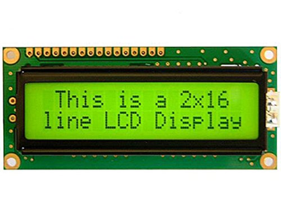
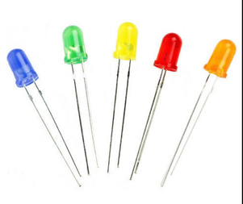
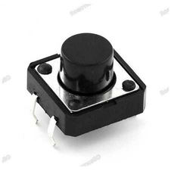
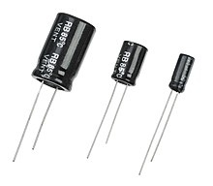
Main Components
ARDUINO UNO (ATMEGA328P)
LCD DISPLAY LM016L
EM-18(RFID READER MODULE)
ATmega328P microcontroller serves as the central processing unit
Handle task such as reading button inputs, receiving data from the RFID reader module, update LCD Display
The LCD display module receives data from the microcontroller and updates the display accordingly.
It displays information such as candidate names, their respective vote counts, voting messages, and instructions.
When an RFID tag is scanned by the RFID reader module, it receives data from the RFID tags and passes it to the microcontroller.
LED INDICATOR
PUSH BUTTONS
CAPACOTORS
The LED indicator blinks when the RFID tag is valid.
There are four buttons for each candidate users can press one of the buttons to mark their vote.
The capacitor is added in parallel with the push button.
It helps to debounce the button.
Prevents multiple false button presses.
9

Slide 11
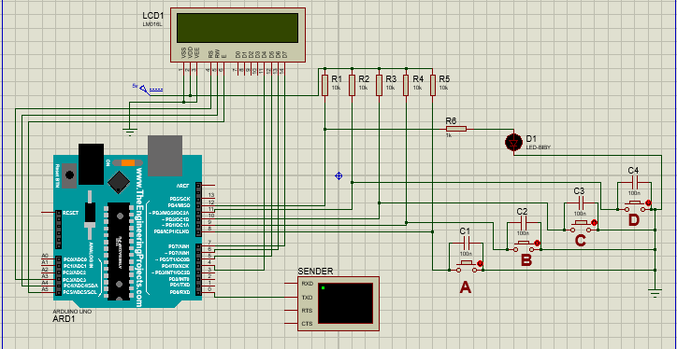
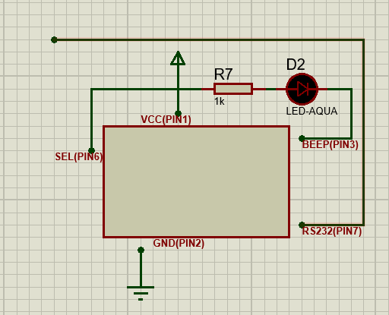
PROTEUS SIMULATION
replaces
10

Slide 12
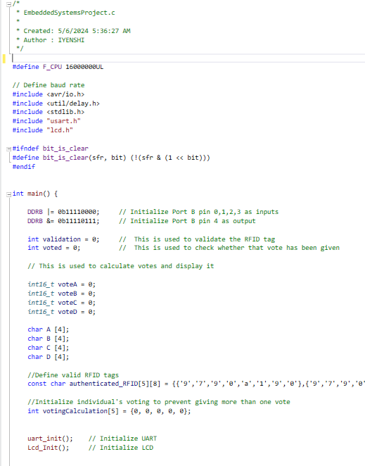
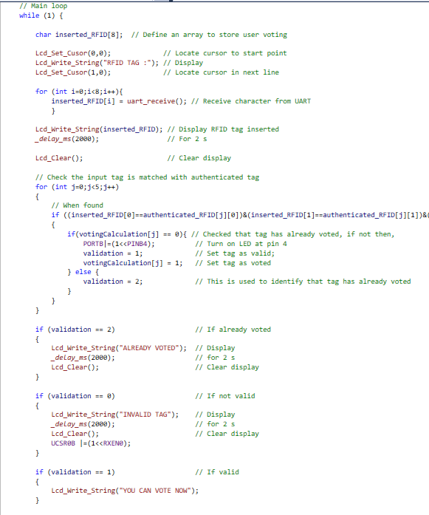
Code
11

Slide 13
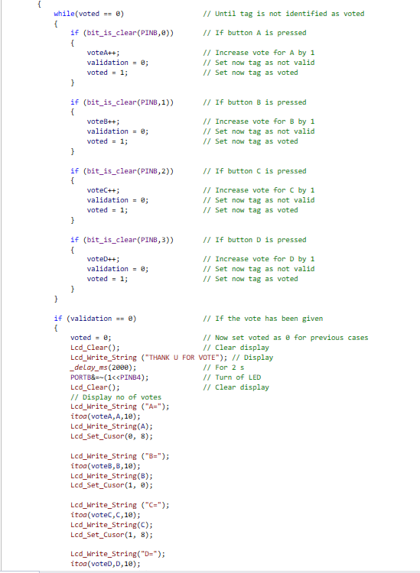
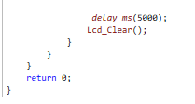
12

Slide 14
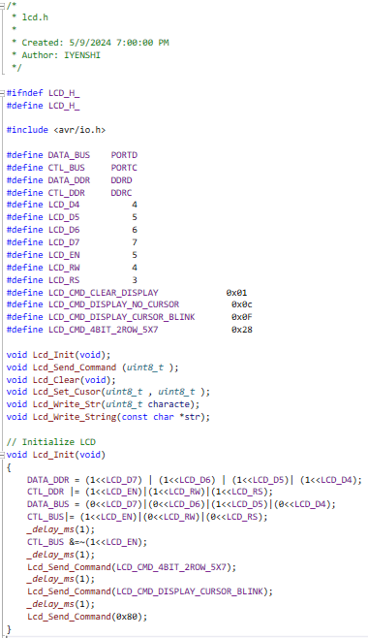
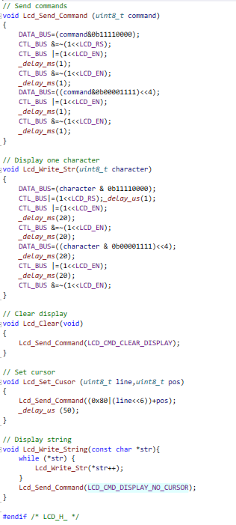
13

Slide 15
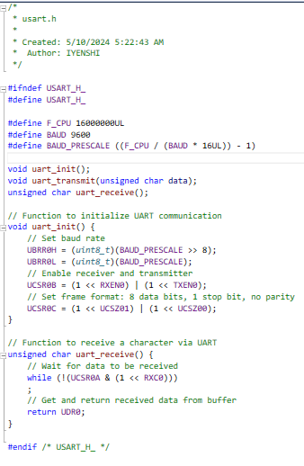
14

Slide 16
Q&A
15

